Slide 1


PROJECT PRESENTATION ON
Contribution to Open Source in
Technology
SEM : VII SH-2022
GUIDE : Prof. Renuka Chimankhare
STUDENTS :
TU4F1920062 / A-60 / Vaibhavi Kharkar
TU4F1920059 / A-57 / Abhishek Sharma
TU4F1920061 / A-59 / Rahul Karkun
TU4F1920053 / A-49 / Sanika Pharande
DEPARTMENT OF INFORMATION TECHNOLOGY

Slide 2
OUTLINE
Introduction
Literature Review
Problem Statement
Objectives of Contribution
Proposed Methodology
Conclusion
DEPARTMENT OF INFORMATION TECHNOLOGY

Slide 3
INTRODUCTION
Open-Source Software is a type of software whose code is publicly available to use and modify. Open-Source Contribution involves contributing to the development or improvement of open-source software.
Open source software is one where authors make it source code available to others who would like to view that code, copy it, learn from it, alter it, or share it. Libreoffice and GNU Image manipulation program are examples of open source software.
An open-source contribution is a great place where you can collaborate with other developers by improving their code or correcting them.
You get to learn more about programming when you are on your coding journey. During your learning phase, you not only learn the specific language or basic syntax but also understand how things can be applied in real-world projects.
DEPARTMENT OF INFORMATION TECHNOLOGY

Slide 4
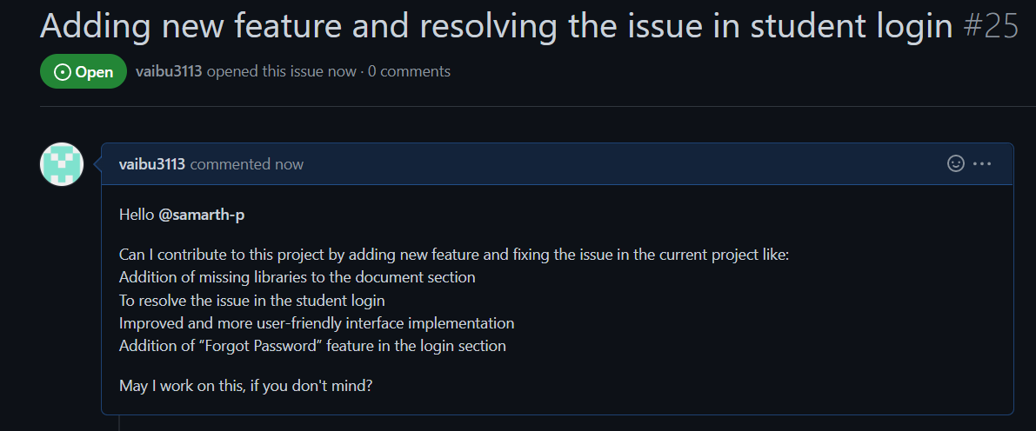
INTRODUCTION CONT’D
This project College ERP which is used for college management system and built using Django framework. It is designed for interactions between students and teachers. Features include attendance, marks and time table.
Therefore, in this project, we intended to contribute to the documentation, add forgot password feature to the login function, improve the user interface & design and fix the issue that prevented students from logging in.
DEPARTMENT OF INFORMATION TECHNOLOGY

Slide 5
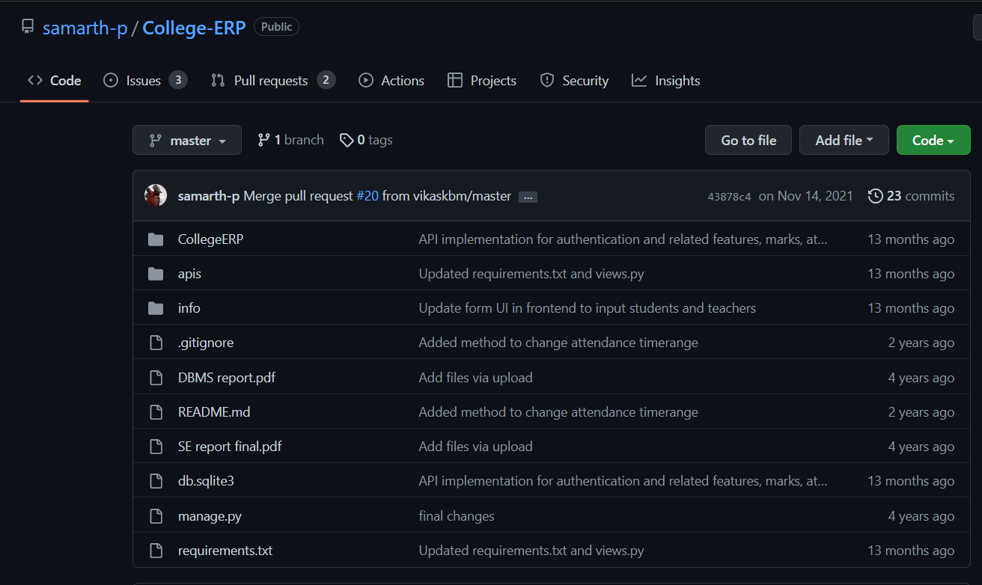
INTRODUCTION CONT’D

Slide 6
LITERATURE SURVEY
Sr. No. | References | Technology Used | Features | Drawbacks
1 | Intrusion Detection System for College ERP System | JDK 1.7 MYSQL NETBEANS Network Intrusion Detection System(NIDS) | This system provides security to the College ERP system | Students must sign into their college accounts to purchase books and register for tests that are hosted on the college's main server.
2 | Education ERP System | PHP MYSQL Apache server HTML,CSS,node.js, javascript | Simple and User friendly App with basic ERP features | This system is not suitable for large applications.
Sr. No.
Reference
Technology Used
Methodology Used
Features
Drawbacks
DEPARTMENT OF INFORMATION TECHNOLOGY

Slide 7
LITERATURE SURVEY
Sr. No. | References | Technology Used | Features | Drawbacks
3 | E-College: An ERP for Educational Institute | Apache PHP MYSQL | Easy to use Fast and Efficient for small amount of college students | This system does not support large databases size as efficiently
4 | College ERP System | Xampp v3.3 Operating system:Windows | A user-friendly interface with a robust data system. Students and parents can both utilize this ERP system. | There is no security offered by this system. For the database user, there is no password.
Sr. No.
Reference
Technology Used
Methodology Used
Features
Drawbacks
DEPARTMENT OF INFORMATION TECHNOLOGY

Slide 8
PROBLEM STATEMENT
Some libraries are not listed in the College ERP documentation.
The current college ERP system has a problem with data interlinking, which makes it difficult for students to log in.
The User Interface of the College ERP is very basic and thus not very user friendly.
The "Forgot Password" option is not available on the current login page.
DEPARTMENT OF INFORMATION TECHNOLOGY

Slide 9
OBJECTIVES
Addition of missing libraries to the document section
To resolve the issue in the student login
Improved and more user-friendly interface implementation
Addition of “Forgot Password” feature in the login section
DEPARTMENT OF INFORMATION TECHNOLOGY

Slide 10
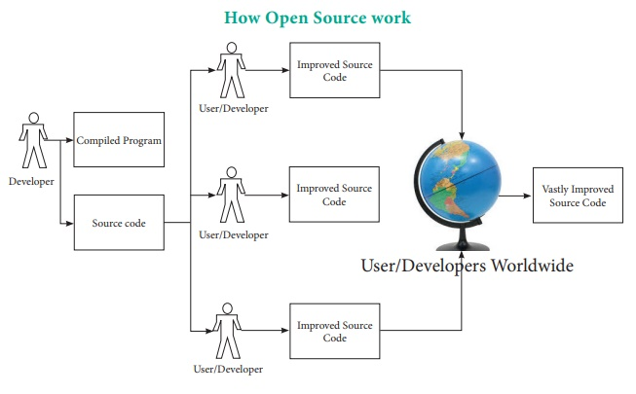
PROPOSED METHODOLOGY CONT’D
DEPARTMENT OF INFORMATION TECHNOLOGY

Slide 11
CONTRIBUTION
In this project, we wanted to contribute to an open-source Django-based web application by adding new functionality to an existing system via a GitHub repository.
This project attempted to reinvent an existing web application by solving an error on the student login page and adding new functionality i.e FORGOT PASSWORD,improving the DOCUMENTATION and Addition of missing libraries to the document section.
While adding the information about various other steps required to run the web app on a local computer
Simplifying and redefining the basic structure of web app to make them more comfortable, attractive, and easy to use, while redesigning them to be easier for users to use and interact with.
DEPARTMENT OF INFORMATION TECHNOLOGY

Slide 12
REFERENCES
[1]http://www.journalcra.com/article/intrusion-detection-system-college-erp-system.
[2] Gupta, K.K. , Nath, B. , Kotagiri, R. “Layered Approach Using Conditional Random Fields for Intrusion Detection”, Dependable and Secure Computing,IEEE Transactions on (Volume:7 , Issue: 1 ), Jan.-March 2010, Page 35 – 49.
[3] “Comprehensive Windows Event Log Monitoring - Servers, Desktops &amp; Devices”,June 12, 2014.
[4] Ajith Abraham, Ravi Jain, Johnson Thomas, and Sang Yong Han, "D-SCIDS: Distributed soft computing intrusion detection system." Journal of Network and Computer Applications 30, no. 1 (2007): 81-98.
[5] Mohammad A. Faysel, Syed S . Haque, “Towards Cyber Defense: Research in Intrusion Detection and Intrusion Prevention Systems”, IJCSNS International Journal of Computer Science and Network Security, Vol.10No.7, July 2010, pp. 316-325.
DEPARTMENT OF INFORMATION TECHNOLOGY

